Slide 1

Instagram User Engagement Analysis Using SQL
Created By : Sakshi Dive

Slide 2
Project Overview
This project focuses on analyzing user interactions and engagement on Instagram to extract actionable insights that can drive business growth. User analysis tracks how individuals interact with the app helping businesses make data-driven decisions across various teams such as marketing , product and development to enhance user experience and drive business growth.
Using SQL and MySQL Workbench, this analysis answers key management questions providing valuable insights to shape the app's future direction.

Slide 3
Objectives
The primary goal of this project is to utilize SQL to analyze Instagram user data and derive meaningful insights that can support strategic decision-making. Specifically, this project aims to answer following questions:
Identify the 5 Most Active Users on the platform based on their posting activity.
Determine which User received the Highest Number of Likes on a single photo.
Analyze the Tags associated with the Most Liked Photo to identify trends in user preferences.
Discover and recommend the 5 most commonly used Tags on the platform to enhance engagement.
Examine user registration trends to determine the Day of the Week with the Highest Registrations.
Identify users who have Never posted to understand Inactive or Passive user behavior.
Detect users exhibiting Bot-like or Fake Account Behavior through patterns of excessive or automated engagement, such as liking every photo.

Slide 4
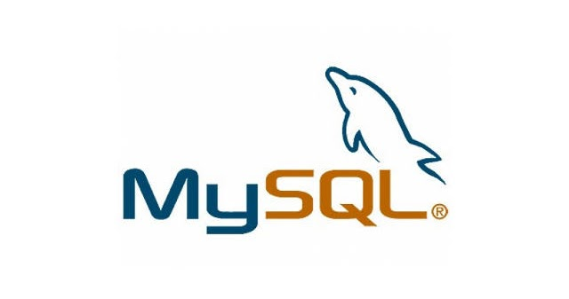
Dataset and Tools Used
Dataset : The dataset “instagram_db” consist of 6 tables
1. Users : Information about users 2. Photos: Data about photos posted by users 3. Likes: Records of which users liked which photos 4. Follows: Follower-followee relationships 5. Tags: Information about tags 6. Photo Tags: Tags associated with photos
Tools Used :
SQL : Querying and Analyzing the data
MySQL Workbench : Managing database and executing queries.
This Photo by Unknown Author is licensed under CC BY-SA-NC

Slide 5
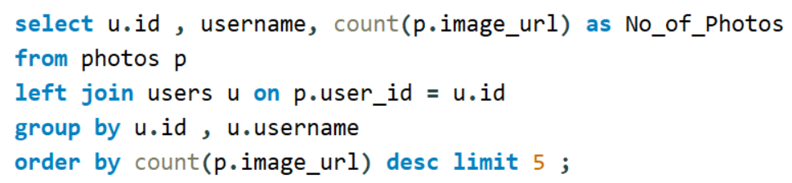
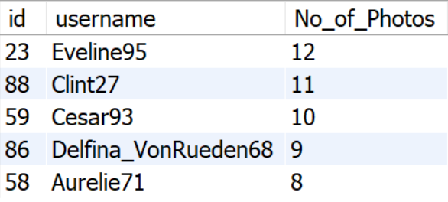
5 Most Active Users on the platform based on posting photos.
Query
Output

Slide 6
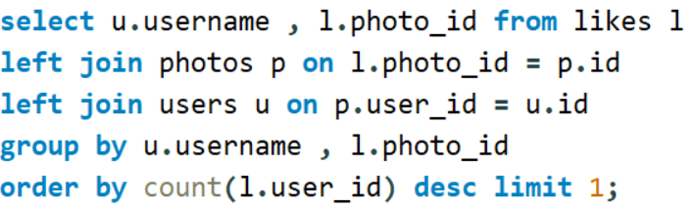
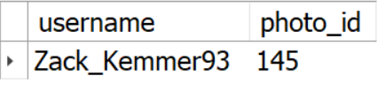
User who received Highest Number of Likes on a Single Photo
Query
Output

Slide 7
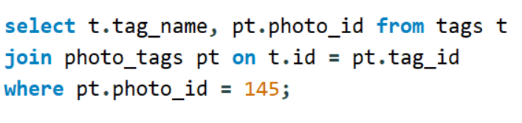
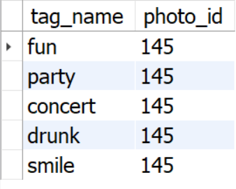
Tags associated with Most Liked Photo
Query
Output

Slide 8
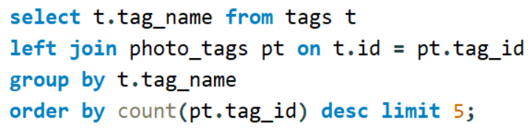
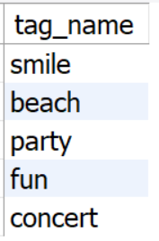
5 Most commonly used Tags
Query
Output

Slide 9
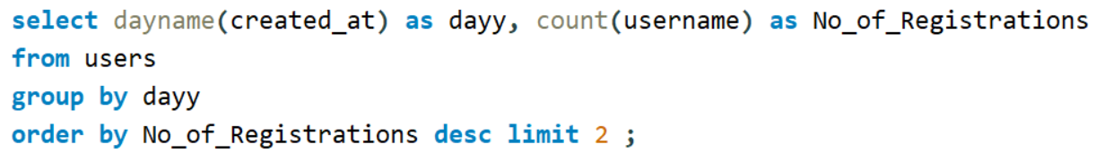
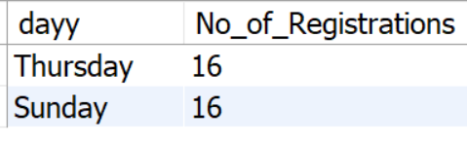
Day of the Week with Highest Registrations
Query
Output

Slide 10
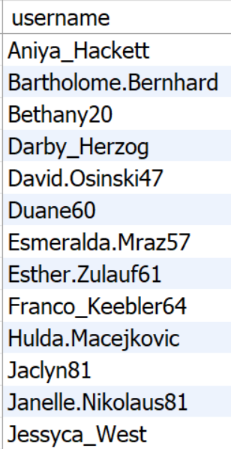
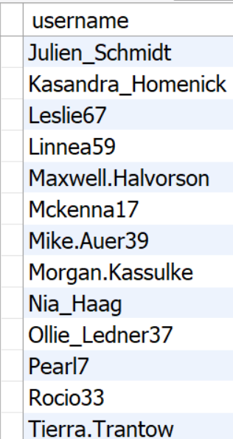
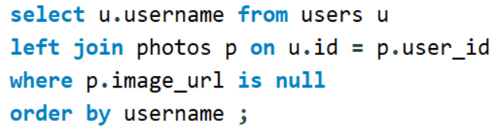
Users who have Never Posted to understand Inactive or Passive User behavior.
Query
Output

Slide 11
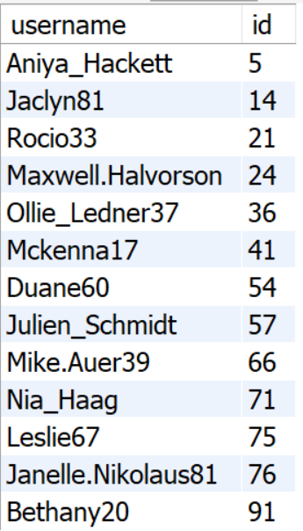
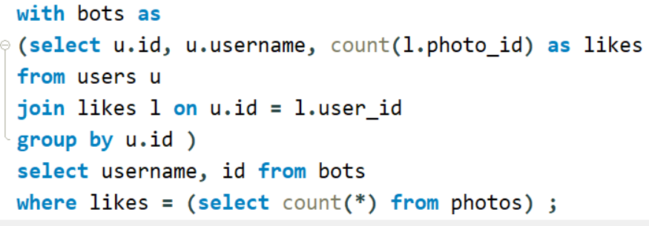
Users exhibiting Bot-like or Fake Account behavior
Output
Query

Slide 12
Insights
User Engagement: Identified the 5 Most Active Users contributing significantly to platform engagement, suggesting potential influencers or brand ambassadors.
Content Trends: Smile, Fun, Party, Concert and Drunk are the tags associated with most liked photo whereas Smile, Beach, Party, Fun & Concert are 5 most commonly used tags which highlights trends in user preferences which can be actionable insights for content optimization.
User Behavior: Detected 13 Users exhibiting Bot-like or Fake Account Behavior enabling the platform to take action against fake accounts which can help to maintain the platform's integrity.
Registration Trends: Thursday and Sunday are the peak days for registrations informing targeted marketing campaigns and opportunities for growth.
Inactive Users: Identified 26 Inactive Users, revealing opportunities for reactivation to encourage user sig-ups.

Slide 13
Recommendations
Leverage Influencers: Engage the most active users through exclusive features, rewards, or collaborations to promote content and maintain their activity and leverage their influence..
Optimize Content Strategy: Encourage the use of popular tags and themes to boost engagement.
Mitigate Fake Accounts: Implement stricter bot detection mechanisms or verification processes to maintain platform authenticity.
Enhance User Activation: Design campaigns targeting inactive users to encourage participation reach out to them with engagement prompts, tutorials, or incentives to encourage their activity.
Schedule promotional ad campaigns and onboarding processes around the peak registration days.

Slide 14
Impacts
Actionable Business Insights: Insights derived empowers Marketing, Product, and Development teams to launch targeted campaigns, introduce new features, and enhance user experience, driving business growth.
Improved User Engagement: Detailed analysis of user activity and tag trends help to optimize content strategies, boosting user interaction and engagement.
Enhanced Platform Trust: Detecting and addressing bot-like behavior ensures accurate engagement metrics, fostering trust among users.
Higher User Satisfaction: Data-driven content optimization makes posts more relevant, increasing engagement rates and user satisfaction.
Strategic Growth Opportunities: Leveraging registration trends and influencer partnership supports marketing campaigns, driving user acquisition and retention.

Slide 15
Conclusion
This project demonstrates how SQL can extract actionable insights to optimize engagement, content strategies, and platform integrity. By analyzing user behavior and trends, we identified growth opportunities and highlighted the critical role of data-driven decisions in enhancing user experience and supporting business success.
This analysis showcases my ability to use SQL to deliver meaningful insights that supports data-driven decisions and business growth.

Slide 16
Thank You !

